Slide 1

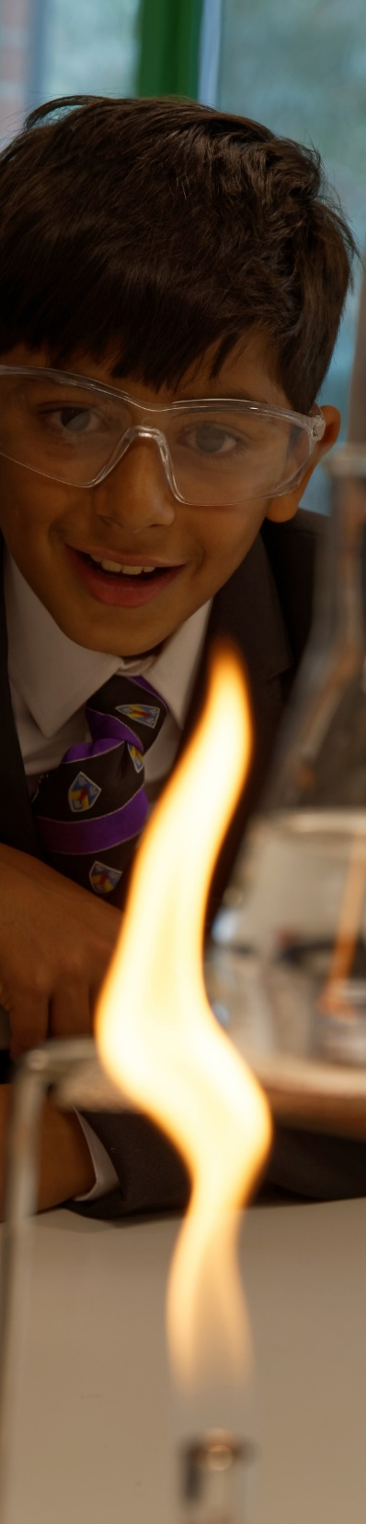
Safeguarding and Wellbeing Concerns
Safeguarding and Child Protection:
If you are concerned about a child, it is important to take action:
Emergency services : Call 999 if a child is in immediate danger
Merseyside Police: Call 101 (non-emergency)
NHS Support: Call 111 (non-emergency)
Knowsley MASH (Social Worker Advice): Call 0151 443 2600
Sefton Children's Help and Advice Team (CHAT): Call 0151 934 4013
(Emergency Duty Team outside of hours, including weekends and bank holidays, on 0151 934 3555)
To contact your designated safeguarding lead in school, please email: safeguarding@pfcmat.org
Mental Health and Wellbeing
NSPCC 24/7 Helpline: Call 0800 800 5000
Liverpool CAMHS Crisis Team: Call 0151 293 3577
Childline: Call 0800 1111
Kooth: https://www.kooth.com
Young Minds: https://www.youngminds.org.uk
Mind: https://www.mind.org.uk
Family Lives: Call 0800 800 2222

